Slide 1





Welcome to the

Slide 2









Computer Vision as a way to discover the history of our cities
Marco Minerva
@marcominerva
Microsoft MVP Windows Development
Riccardo Cappello
@rcappello
Microsoft MVP Microsoft Azure

Slide 3







Sponsors

Slide 4






Microsoft Cognitive Services
Give your apps a human side
Vision
From faces to feelings, allow your apps to understand images and video
Speech
Hear and speak to your users by filtering noise, identifying speakers, & understanding intent
Language
Process text and learn how to recognize what users want
Knowledge
Tap into rich knowledge amassed from the web, academia, or your own data
Search
Access billions of web pages, images, videos, and news with the power of Bing APIs
Labs
An early look at emerging Cognitive Services technologies: discover, try & give feedback on new technologies before general availability
Notes:
M

Slide 5
Microsoft Cognitive Services
Give your apps a human side
Computer Vision
Content Moderator
Emotion
Face
Video
Video Indexer
Custom Vision Service
Bing Speech
Speaker Recognition
Translator Speech
Custom Speech Service
Bing Spell Check
Linguistic Analysis
Text Analytics
Translator Text
Web Language Model
Language Understanding
Academic Knowledge
Entity Linking
Knowledge Exploration
Recommendations
QnA Maker
Custom Decision Service
Bing Autosuggest
Bing Image Search
Bing News Search
Bing Video Search
Bing Web Search
Bing Entity Search
Bing Custom Search
Project Prague (gesture)
Project Cuzco (events)
Project Johannesburg (routing)
Project Nanjing (isochrones)
Project Abu Dhabi (distance matrix)
Project Wollongong (location)
Vision
Speech
Language
Knowledge
Search
Labs
Notes:
M

Slide 6
Microsoft Cognitive Services
Give your apps a human side
Vision
Speech
Language
Knowledge
Search
Labs
Computer Vision
Content Moderator
Emotion
Face
Video
Video Indexer
Bing Speech
Speaker Recognition
Translator Speech
Bing Spell Check
Linguistic Analysis
Text Analytics
Translator Text
Web Language Model
Academic Knowledge
Entity Linking
Knowledge Exploration
Recommendations
QnA Maker
Bing Autosuggest
Bing Image Search
Bing News Search
Bing Video Search
Bing Web Search
Bing Entity Search
Project Prague (gesture)
Project Cuzco (events)
Project Johannesburg (routing)
Project Nanjing (isochrones)
Project Abu Dhabi (distance matrix)
Project Wollongong (location)
CUSTOMIZATION
Custom Vision Service
Custom Speech Service
Language Understanding
Custom Decision Service
Bing Custom Search
Notes:
M

Slide 7
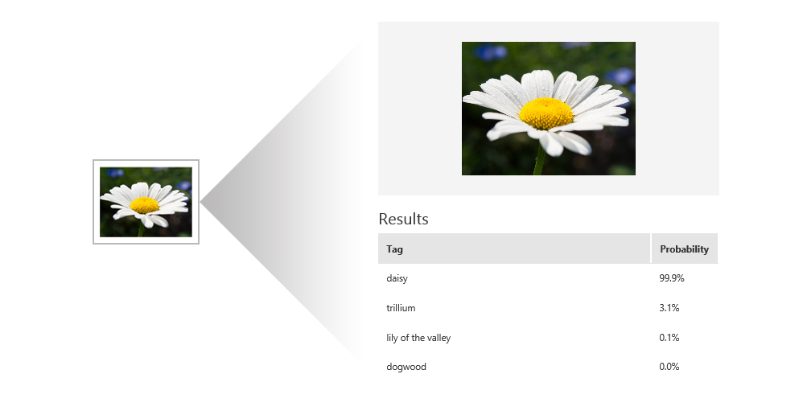
Custom Vision Service
Custom Vision Service leverages the power of machine learning to create and customize state-of-the-art computer vision image recognition models by exposing tools and APIs to build custom image classifiers to training and predict images.
Notes:
M As part of the Microsoft Cognitive Services suite, Custom Vision Service is designed to allow users and developers to customize thier own state-of-the-art computer vision models for unique industry or scenario-specific cases.
Custom Vision Service is accessed via the Custom Vision Service portal at https://customvision.ai/ and exposes a rich set of REST-based APIs for both training and prediction.

Slide 8




How it works
Custom Vision Service is an easy-to-use tool for prototyping, improving, and deploying a custom image classifier to a cloud service, without any background in computer vision or deep learning required.
“cat”
Custom Vision
Model
“dog”
“dog”
Notes:
M

Slide 9
Demo
Azure Portal - Custom Vision Portal
Notes:
R Demo portale

Slide 10
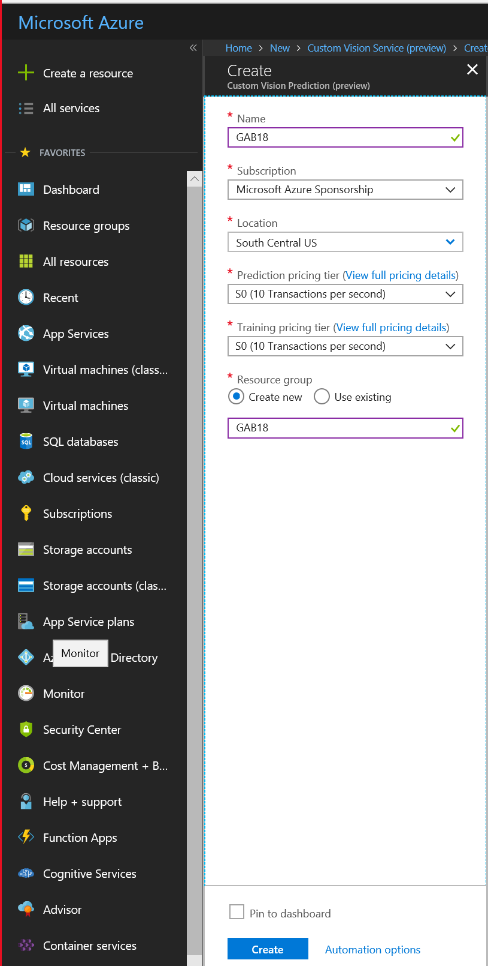
Create Azure Custom Vision service
Optionally, you can create a Custom Vision service resource on Azure.
It’s the only way to bypass Free tiers.
Notes:
R

Slide 11
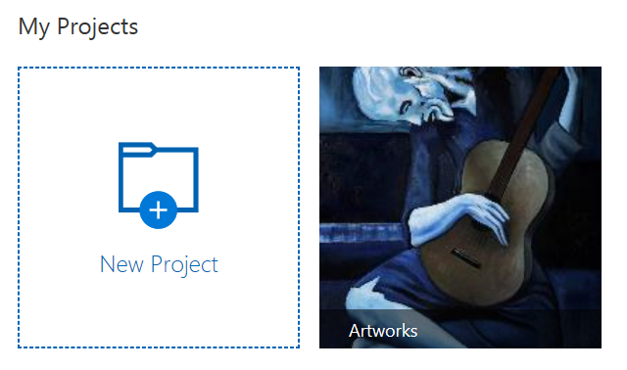
Classifiers, Projects and Domains
A classifier is a model you build using Custom Vision Service, by using a few training images.
When you create a project, you select a domain for that project. The domain optimizes a classifier for a specific type of object in your images.
Classifier = Project
Notes:
R The terms “classifier” and “project”, although not technically the same, are used throughout the Custom Vision Service documentation to reference the same technical concept: A logical grouping of images, tags, and training iterations.
Each classifier you build is in its own project.
A “domain” optimizes a classifier for a specific type of object in images. For example, if a scenario is to classify between images of buttermilk pie versus images of Bundt cake, then a user would select the "Food" domain. If users are unsure of which domain to choose, the would typically just select the "Generic" domain.
Food Optimized for dishes you would see on a restaurant menu.
Landmarks Optimized for recognizable landmarks, both natural and artificial.
Retail Optimized for classifying images in a shopping catalog or shopping website.
Adult Optimized to better define between adult content and non-adult content.

Slide 12

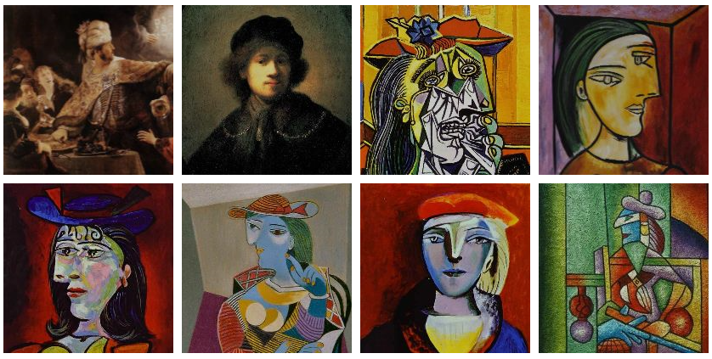
Training Images
To create a high precision classifier, Custom Vision Service needs several training images.
Notes:
R To create a high precision classifier, Custom Vision Service needs several training images. A training image is a photograph of the image you want Custom Vision Service to classify. For example, to classify pineapples, you would need to upload several images of pineapples to Custom Vision Service to allow the service to create a classifier that can recognize oranges. Although not required, the Custom Vision Service recommends using a minimum of 30 images per tag.

Slide 13
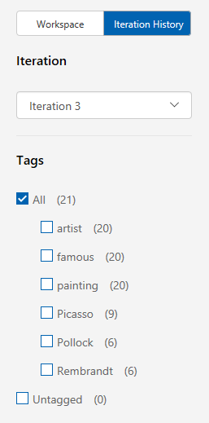
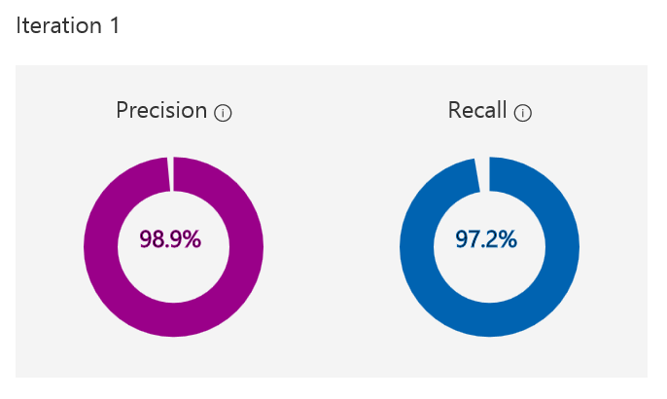

Iteration
Every time you Train or re-train your classifier, you create a new iteration of your model.
Notes:
R Every time you train or re-train your classifier, you create a new iteration of your model. Custom Vision Service maintains several past iterations to allow users to compare your progress over time. Users can delete any iteration at any point, if an iteration is no longer deemed useful. Important: Deleting an iteration is permanent, and also deletes any images or changes that were unique to that iteration.
The terms “precision” and “recall” may seem similar at first glance. Although these terms are related, they each describe a specific aspect of a classifier training.

Slide 14
Important Terms
Precision When you classify an image, how likely is your classifier to correctly classify the image? Out of all images used to train the classifier (Picasso, Rembrandt, and Pollock), what percent did the model get correct? 99 correct tags out of 100 images gives a Precision of 99%.
Recall Out of all images that should have been classified correctly, how many did your classifier identify correctly? A Recall of 100% would mean, if there were 12 Picasso paintings in the images used to train the classifier, 12 Picasso paintings were found by the classifier.
Notes:
M The terms “precision” and “recall” may seem similar at first glance. Although these terms are related, they each describe a specific aspect of a classifier training.
• Precision: considerando tutte le volte in cui ad un’immagine viene assegnato un certo tag, in quale percentuale tale classificazione è corretta? Ad esempio, se viene assegnato il tag corretto a 95 immagini su un totale di 100, la precisione è del 95%.
• Recall: una sorta di “opposto” della Precision: considerando il totale di immagini con un certo tag, in quale percentuale questo tag viene effettivamente assegnato? Se nel modello ci sono 15 immagini con quel tag, ma il classificatore ne assegna 10, la Recall è del 66%.

Slide 15
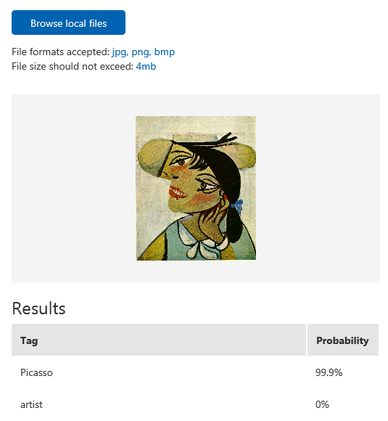
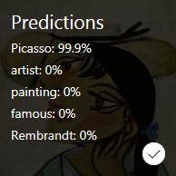
Testing a Model
After you train your model, you can quickly test it using a locally stored image or an online image.
Notes:
R Adding single images before retraining a model doesn't lead to significant performance gains. For best results, users should add a significant number of images before retraining.
The most useful tool for evaluating potential adjustments to a model training is the use of the Predictions tab in the Custom Vision Service portal.
The test uses the most recently trained iteration.

Slide 16
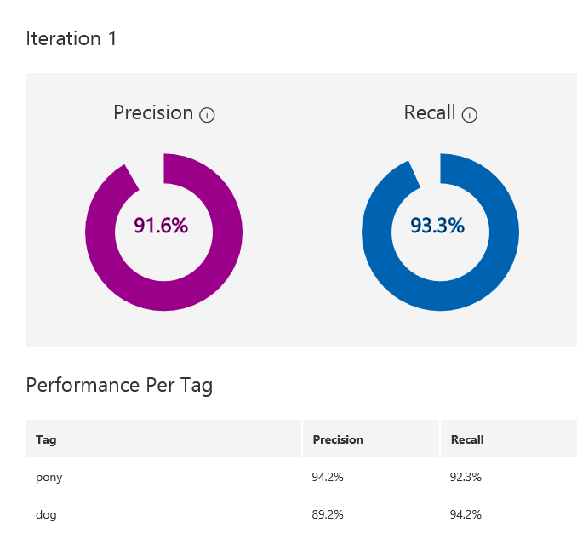
Improving a Classifier
The best way to have a quality classifier is to add more varied tagged images (different backgrounds, angles, object size, groups of photos, light condition, and variants of types.)
Notes:
R There are a large number of ways to improve the accuracy and reliability of a classifier, many of which require initial human interaction. The primary way to improve a classifier is to add more varied and tagged images. Over time, consistent image tagging is the most reliable way to improve a classifier.
A classifier will learn characteristics that photos have in common, not necessarily the characteristics a user is thinking of. For example, if all your daffodils were photographed outdoors in a field, and all the tulips were photographed in front of a blue wall in a red vase, you have likely trained a “field vs wall+vase” classifier, not daffodils vs tulips.
Always train your classifier after you have added more images. Include images that are representative of what your classifier will encounter in the real world. Photos in context are better than photos of objects in front of neutral backgrounds, for example.

Slide 17
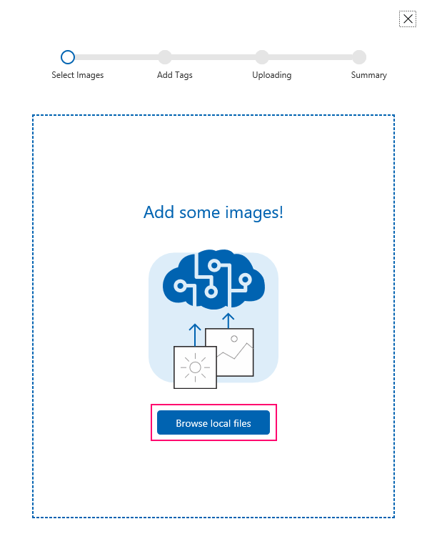
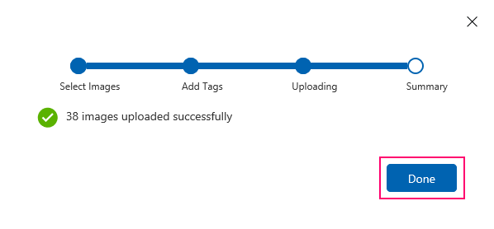
Recap - Building a Classifier
Create a project
Select a domain
Add images
Assign tags to images
Train the classifier
Evaluate the classifier
Notes:
R Building a classifier is essentially the process of creating a project. Project creation can occur via the Custom Vision Service portal, or via the REST-based Training API. All essential aspects of building classifiers (or creating and managing projects) can be achieved via the REST API.

Slide 18
Commonly Used APIs
Training
Prediction
Create images
Tag images
Create projects
Manage projects
Manage iterations
Create tags
Get account information
Train a project
Export iterations (compact domain)
Predict images
Predict and save images
Predict image URLs
Predict and save image URLs
Notes:
M Virtually all methods and features necessary to create end-to-end Custom Vision Service solutions are possible via the Custom Vision Service REST APIs. The Custom Vision Service APIs are categorized into two (2) groupings:
Training APIs
Prediction APIs
All account and project management APIs are grouped under training, as a separate “management” API is not currently available.

Slide 19
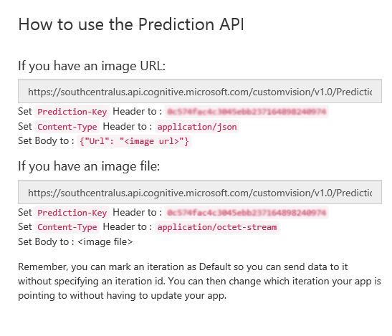
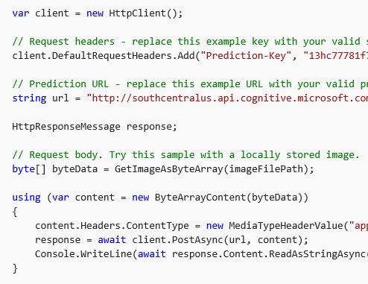
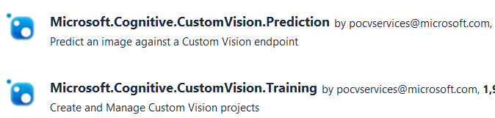
Using the Prediction API
Notes:
M Unlike most other Cognitive Service offerings, Custom Vision Service management is not currently accessed via the Azure portal, but is instead managed via the Custom Vision Service portal. Instead of using a “subscription key”, Custom Vision Service APIs use either a “Training Key” or a “Prediction Key” depending on the APIs being used.
The appropriate endpoint is determined via a combination of a location-specific URL, combined with a user-specific project identifier: ProjectId
API authentication occurs via a standard HTTPS request header, appropriately populated with either a Training Key or Prediction Key. Since the Custom Vision Service APIs are REST-based, use of the APIs can occur via any tool or programming language that can make simple HTTPS requests. Like all REST APIs, the action verb typically controls the activity, such as GET, POST, PUT, and DELETE.
Many of the Custom Vision Service APIs expose “variations” of methods. For example: Images can be predicted by sending the API an external available URL OR sending the API the actual file (binary) representation of the image.

Slide 20
Demo
Custom Vision App
Notes:
M Demo app

Slide 21
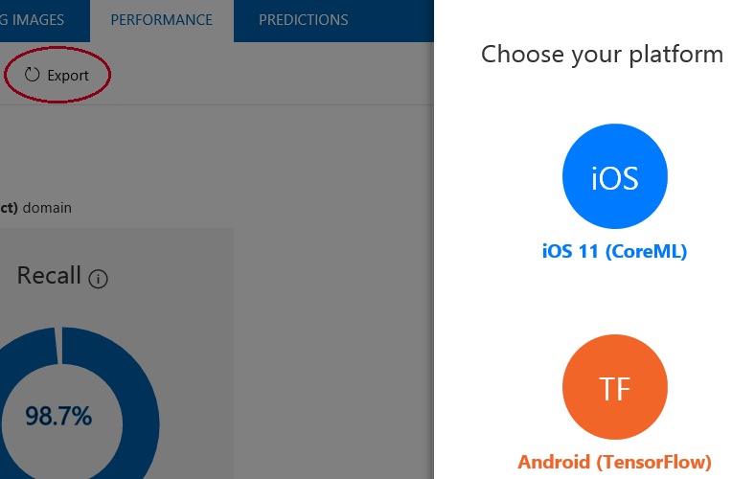
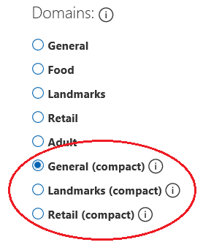
What about connectivity?
Custom Vision is a cloud service, but the model can be exported to run it locally on the device
Notes:
R

Slide 22
Demo
Custom Vision offline models
Notes:
M - Android
R - iOS

Slide 23
Vision Guide
A way to discovery the history of our cities
Notes:
M

Slide 24
The idea
Custom Vision just returns the tag of the recognized image
It’s up to us to use this information to build applications with a real added value
So, why don’t use Custom Vision as the starting point to provide information about the photos that are recognized?
Notes:
M

Slide 25
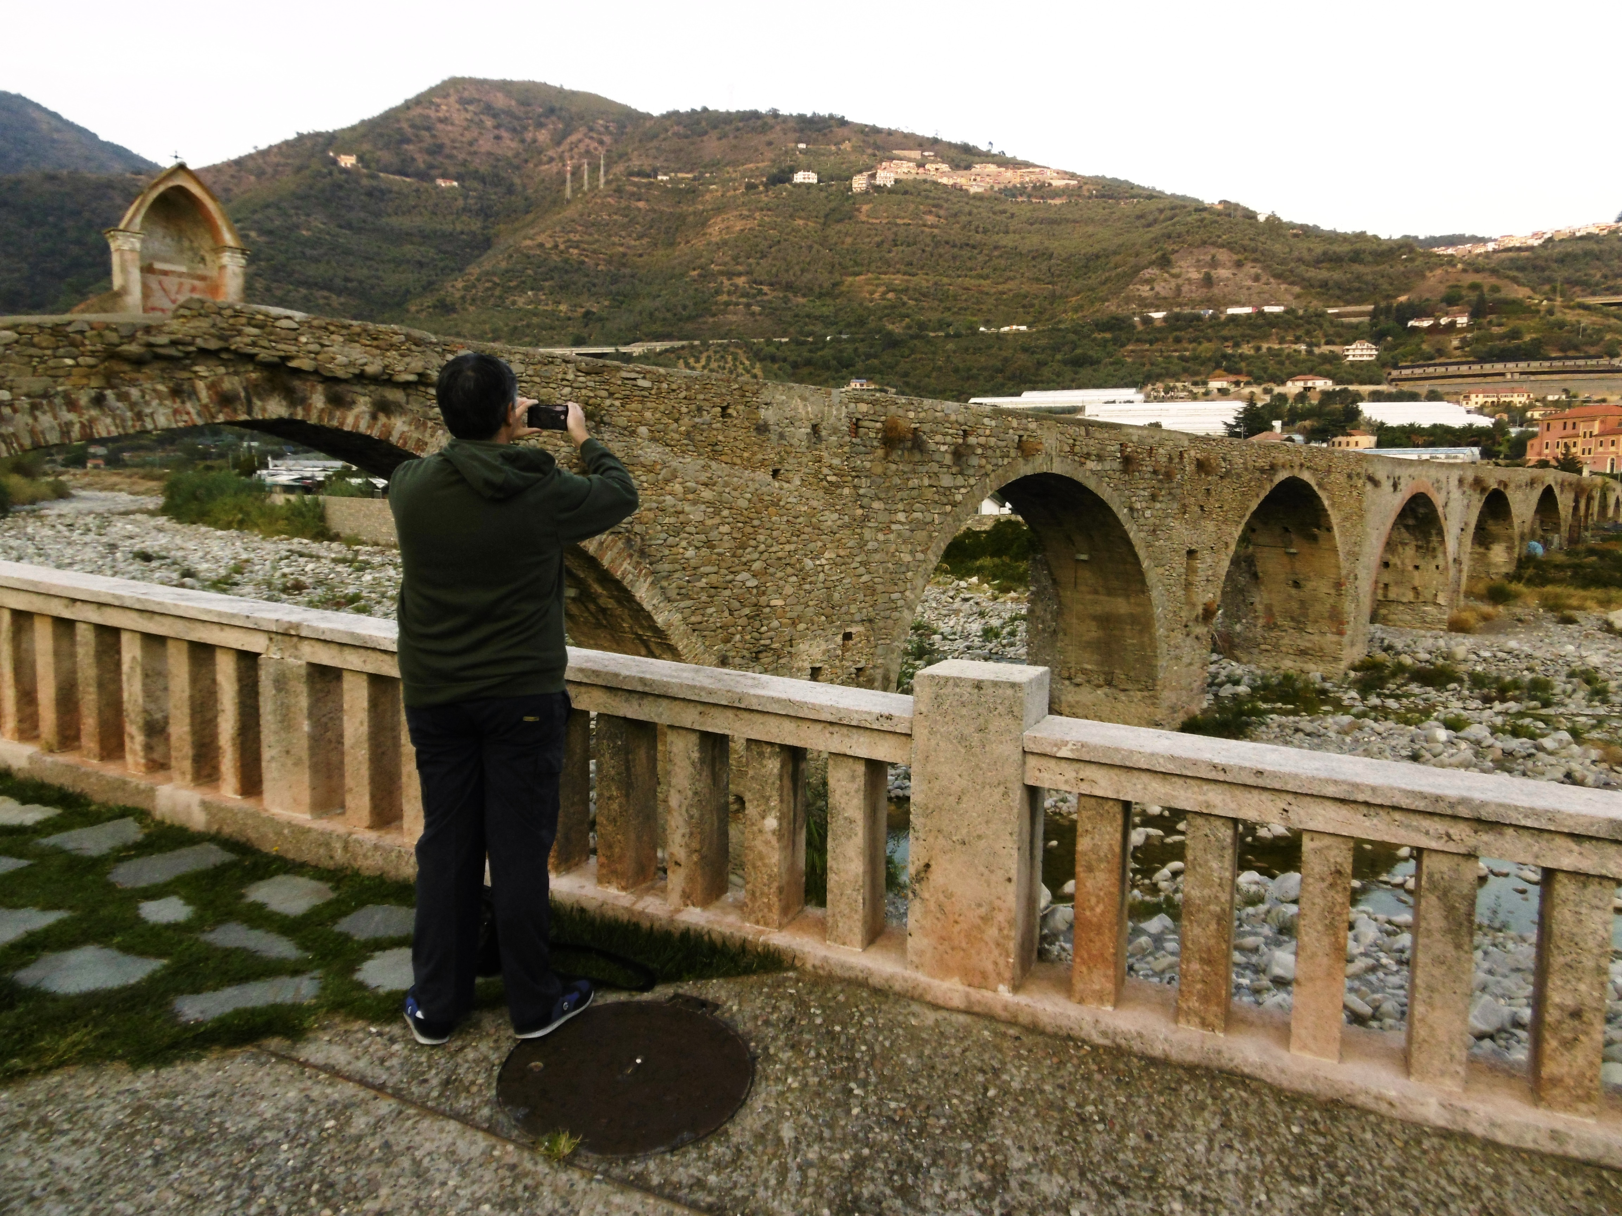
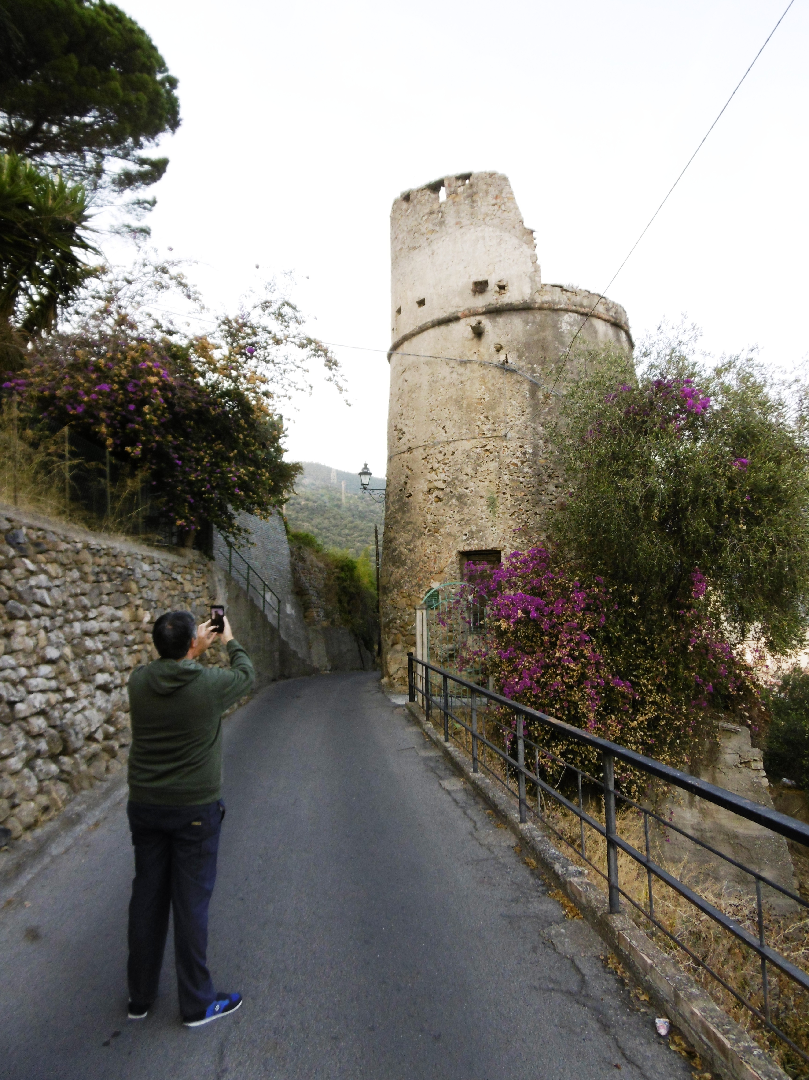
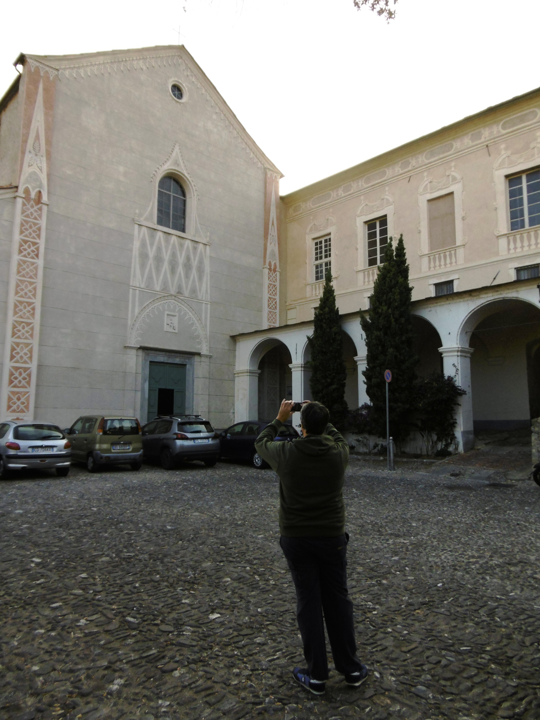
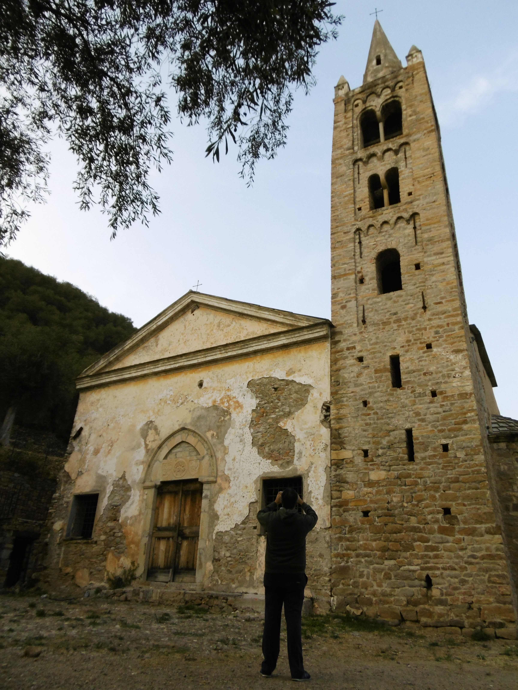
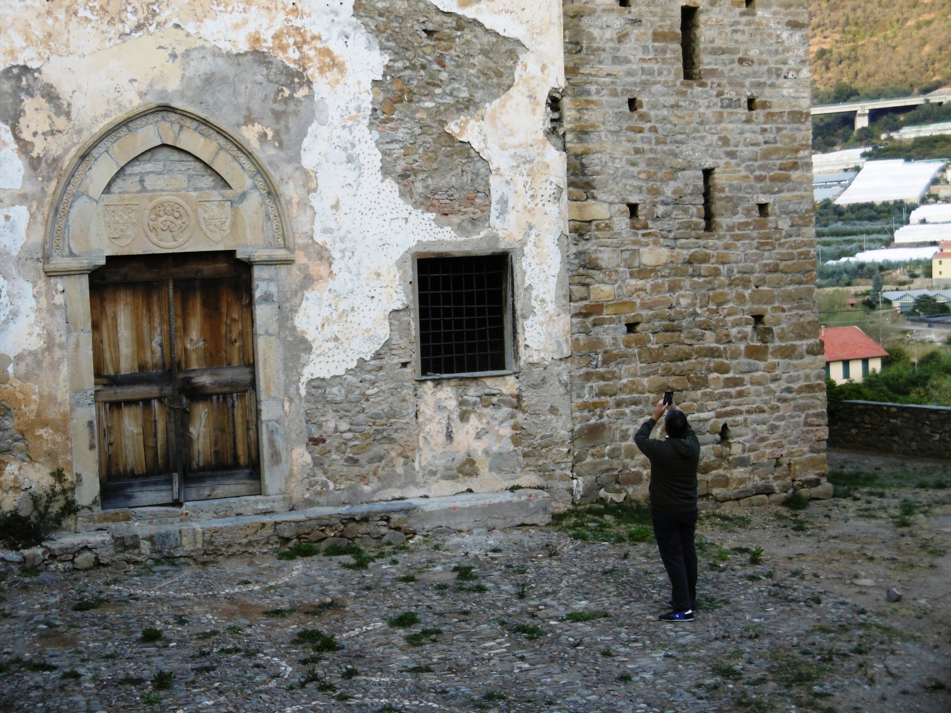
Making of
Notes:
M

Slide 26




How it works: online
Device
Azure
2
1
3
6
4
5
Notes:
R

Slide 27

How it works: offline
Device
1
2
3
4
Notes:
R
Talk about Service price.

Slide 28
Demo
Vision Guide

Slide 29
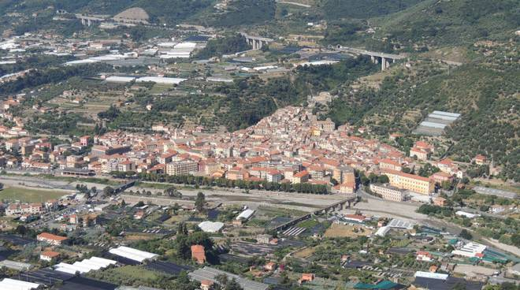
But it isn’t only a demo…
The project is currently in active development for the town of Taggia (IM)
Watch it live
Notes:
M

Slide 30
Future ideas
Use GPS position to improve predictions
Social Integration
Build games based on place identification
Suggestions on nearest places of interest
…
Notes:
R

Slide 31
References
https://azure.microsoft.com/en-us/services/cognitive-services
https://www.customvision.ai
https://docs.microsoft.com/en-us/azure/cognitive-services/custom-vision-service/home
https://github.com/DotNetToscana/CustomVisionCompanion
https://aka.ms/kioskapp

Slide 32

Thank you.
Marco Minerva - @marcominerva
Microsoft MVP – Windows Development
https://about.me/marcominerva
Riccardo Cappello - @rcappello
Microsoft MVP – Microsoft Azure
https://about.me/rcappello
DotNetToscana
Dotnettoscana.org
@dotnettoscana

